Slide 1




Exploring the Next Generation Digital Learning Environment
Dr. Charles Severance
University of Michigan School of Information
www.tsugi.org www.koseu.org

Slide 2
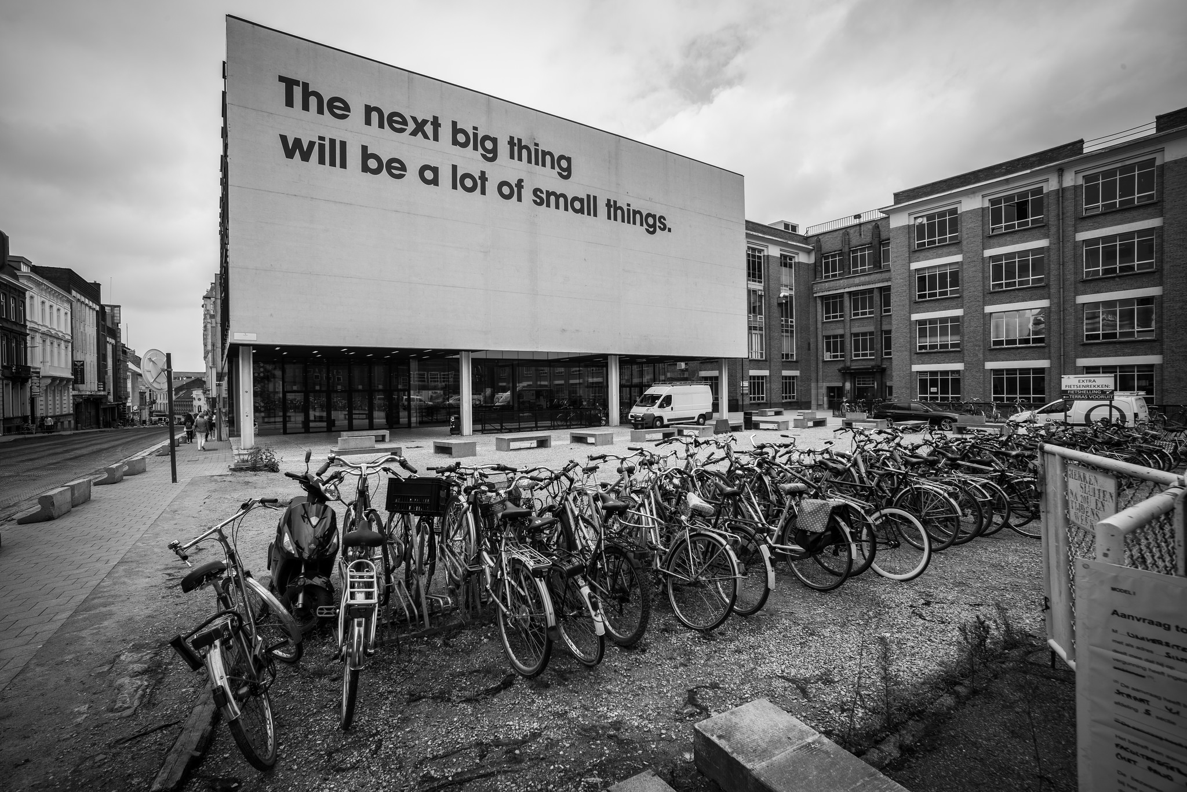
Source: Ian Dolphin

Slide 3

http://planet-fall.deviantart.com/art/The-Monolith-80407794

Slide 4
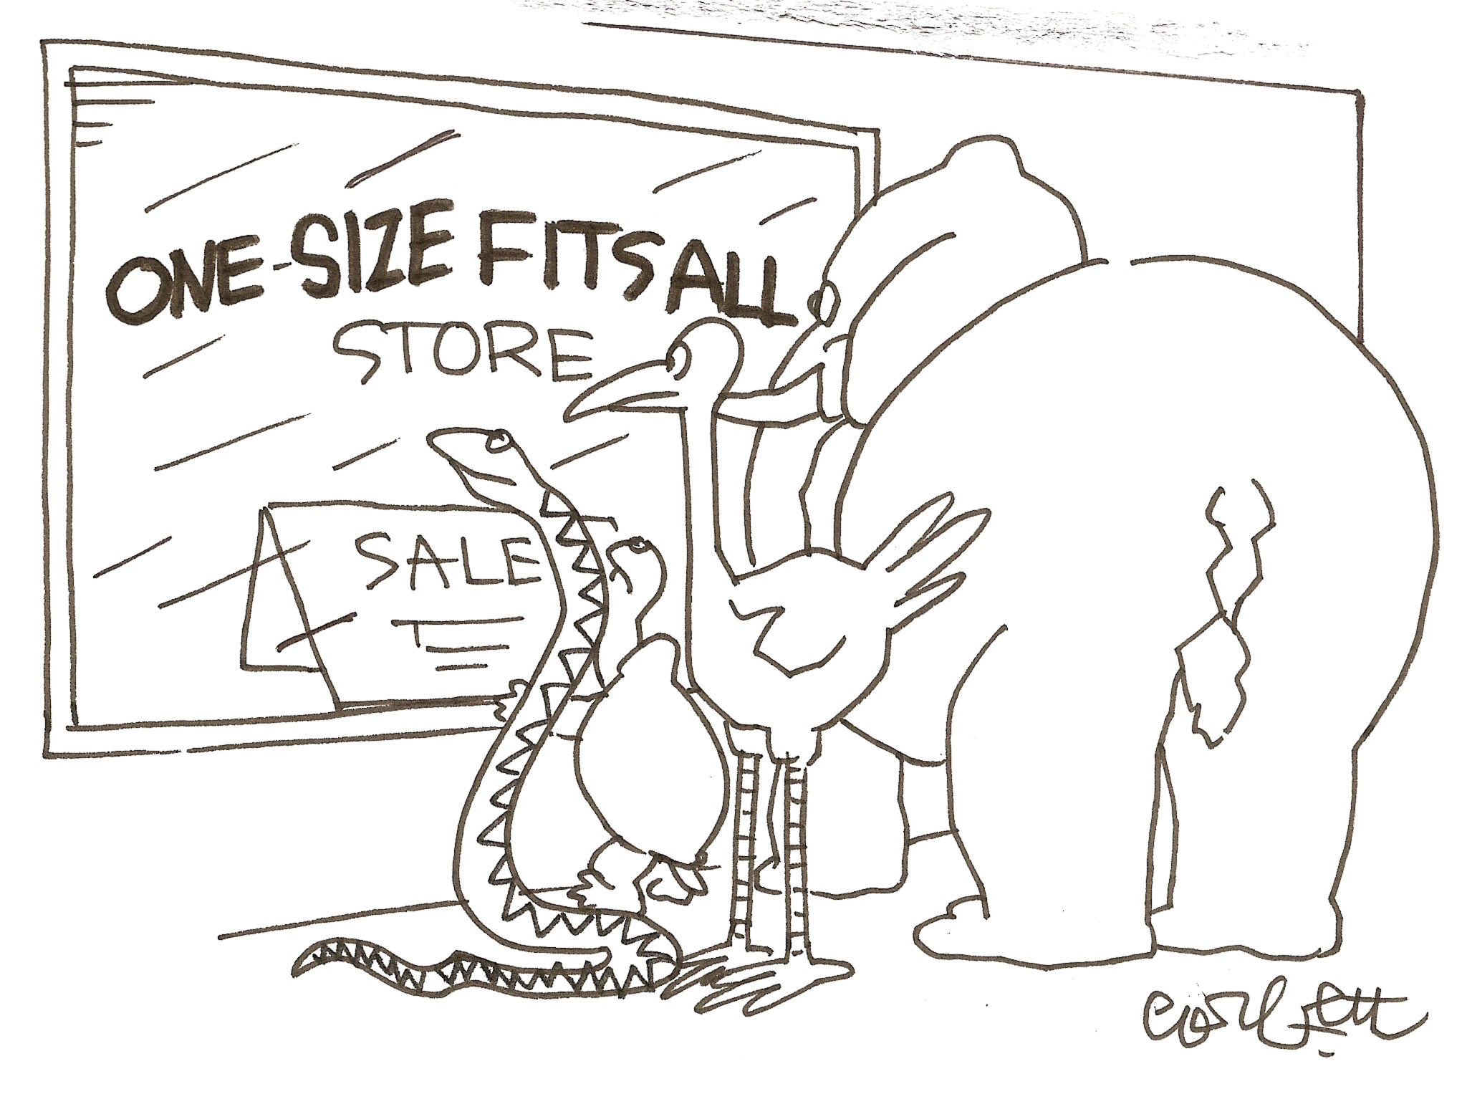

Slide 5
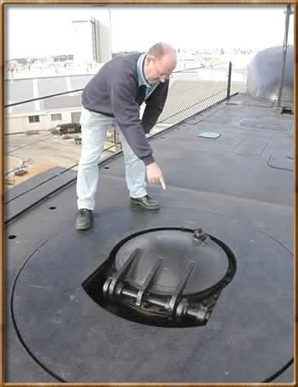

Standards 1.0
IMS Learning Tools Interoperability (LTI) 1.0
17 May 2010
IMS Common Cartridge 1.0
1 October 2008

Slide 6
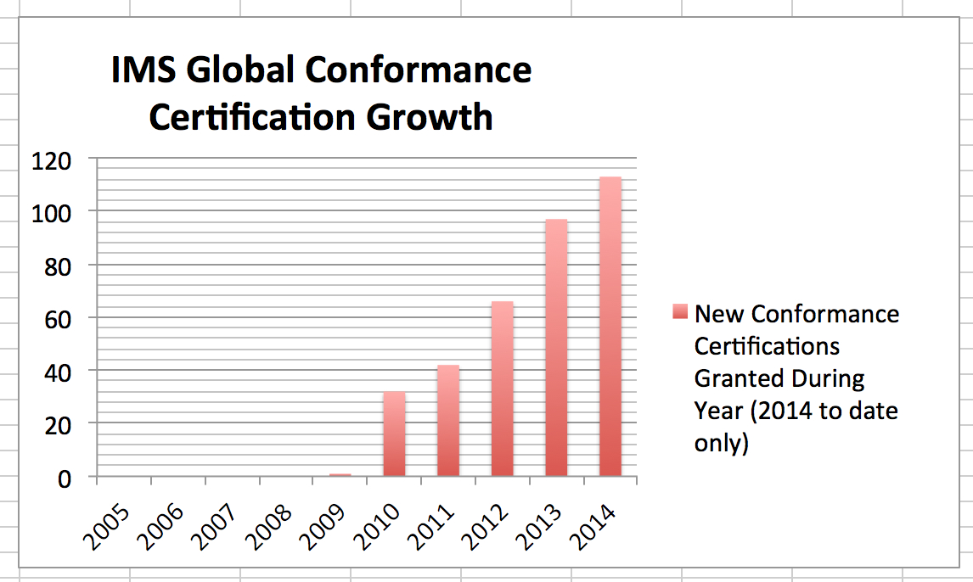
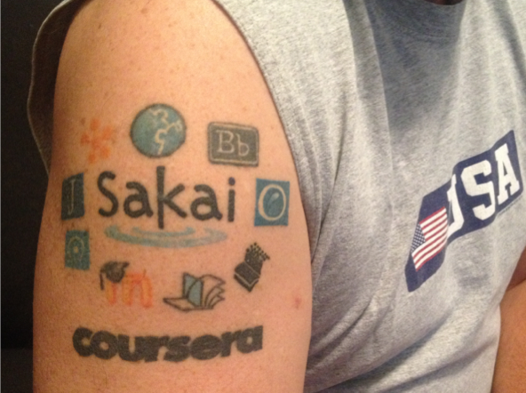

Slide 7


































Slide 8


Standards Next Gen
IMS Common Cartridge – 1.0, 1.1, 1.2, 1.3, 2.0
IMS Learning Tools Interoperability 1.0, 1.1, 2.0, 2.1
IMS LTI Content Item - 1.0
IMS LTI Membership Services – 1.0
Outcomes Management Service 2.0
IMS Caliper 1.0, 1.1
IMS OneRoster – 1.0
IMS CC / EPUB 3.0 Coordination

Slide 9
CONTENT ITEM®
CC®
LTI®
IMS CONTENT ITEM® FILLS THE GAPS AND MAKES CONNECTIONS BETWEEN IMS LEARNING TOOLS INTEROPERABILITY® AND IMS COMMON CARTRIDGE®.
LTI®, CC®, and Content Item® are trademarks of IMS Global Learning Consortium, Inc. (www.imsglobal.org)

Slide 10
CONTENT ITEM®
CC®
LTI®
FOR THE FIRST TIME IN THE HISTORY OF EDUCATIONAL TECHNOLOGY, YOU CAN MAKE AN APP STORE OR LEARNING OBJECT REPOSITORY WITHOUT PROPRIETARY EXTENSIONS.
LTI®, CC®, and Content Item® are trademarks of IMS Global Learning Consortium, Inc. (www.imsglobal.org)

Slide 11
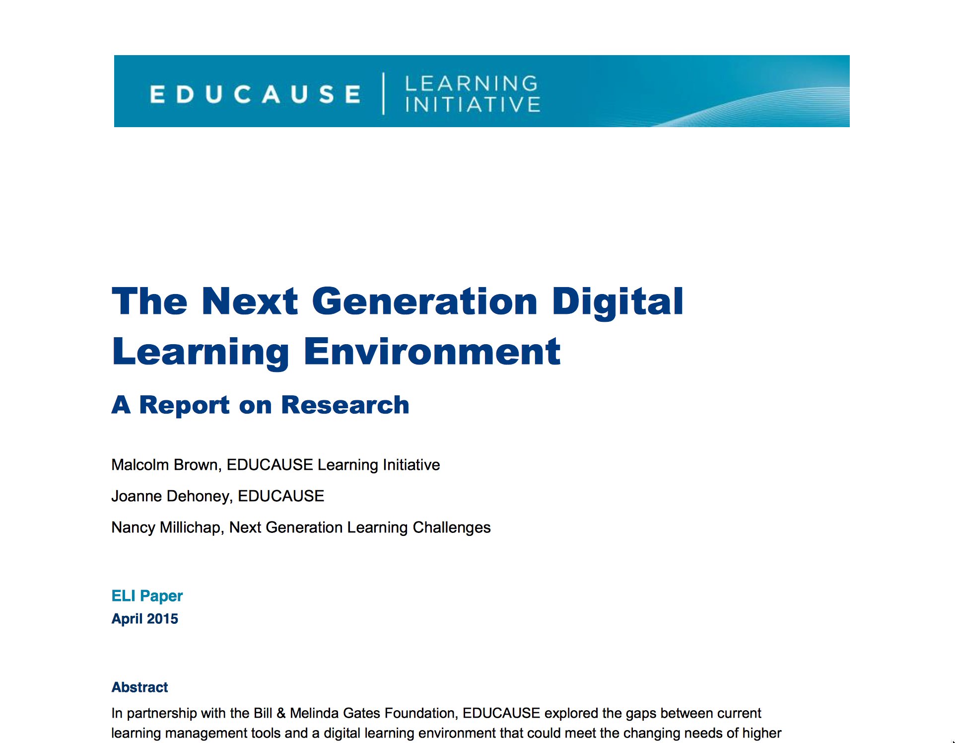
https://net.educause.edu/ir/library/pdf/eli3035.pdf

Slide 12
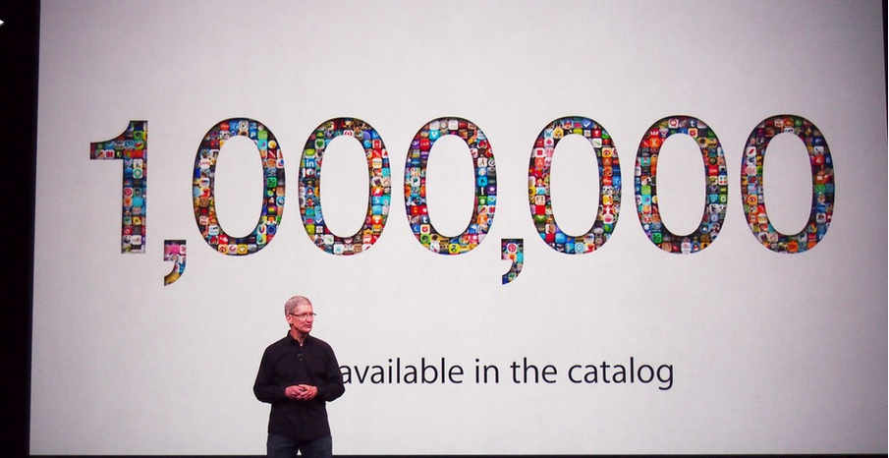
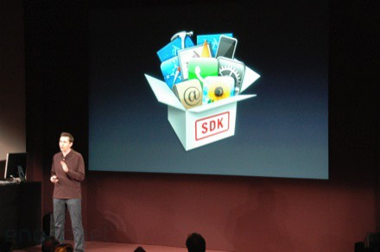
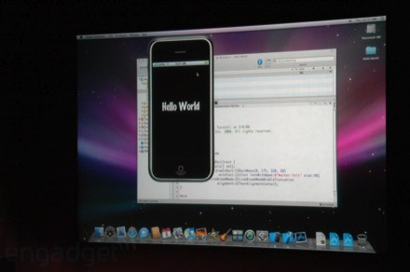
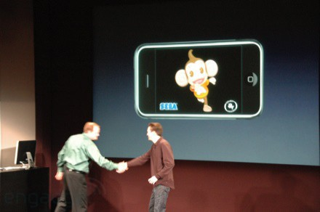
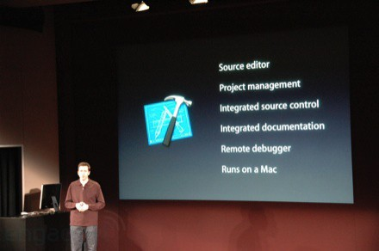
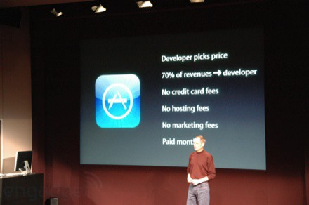
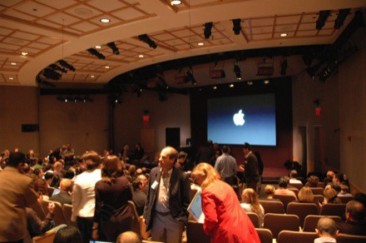
March 6, 2008 iPhone SDK Press Conference

Slide 13

http://planet-fall.deviantart.com/art/The-Monolith-80407794
https://pixabay.com/static/uploads/photo/2014/12/02/22/05/snowflake-554635_960_720.jpg

Slide 14
The Challenge
Need to develop more sophisticated standards for interoperability
Need to train 1000's of developers to read, understand, and implement the standards
As standards improve they expand and get more complex
Impossible?

Slide 15
We need "WordPress"
A free downloadable off-the-shelf software package that gets people going quickly
Allow thousands of educational sites to be built and put into production by anyone

Slide 16
"EduPress"
An Learning Management System (LMS) of my own
An Open Educational Resource site of my own
A Learning Object Repository (LOR) of my own
A Learning Record Store (LRS) of my own
Millions of sites – millions of courses all similar with common capabilities structure and similar but at the same time unique and distinct

Slide 17

What is 次?
Software to allow anyone to build and deploy interoperable educational web sites, content, and learning tools
https://pixabay.com/en/snow-cannon-snow-snow-making-system-999287/

Slide 18
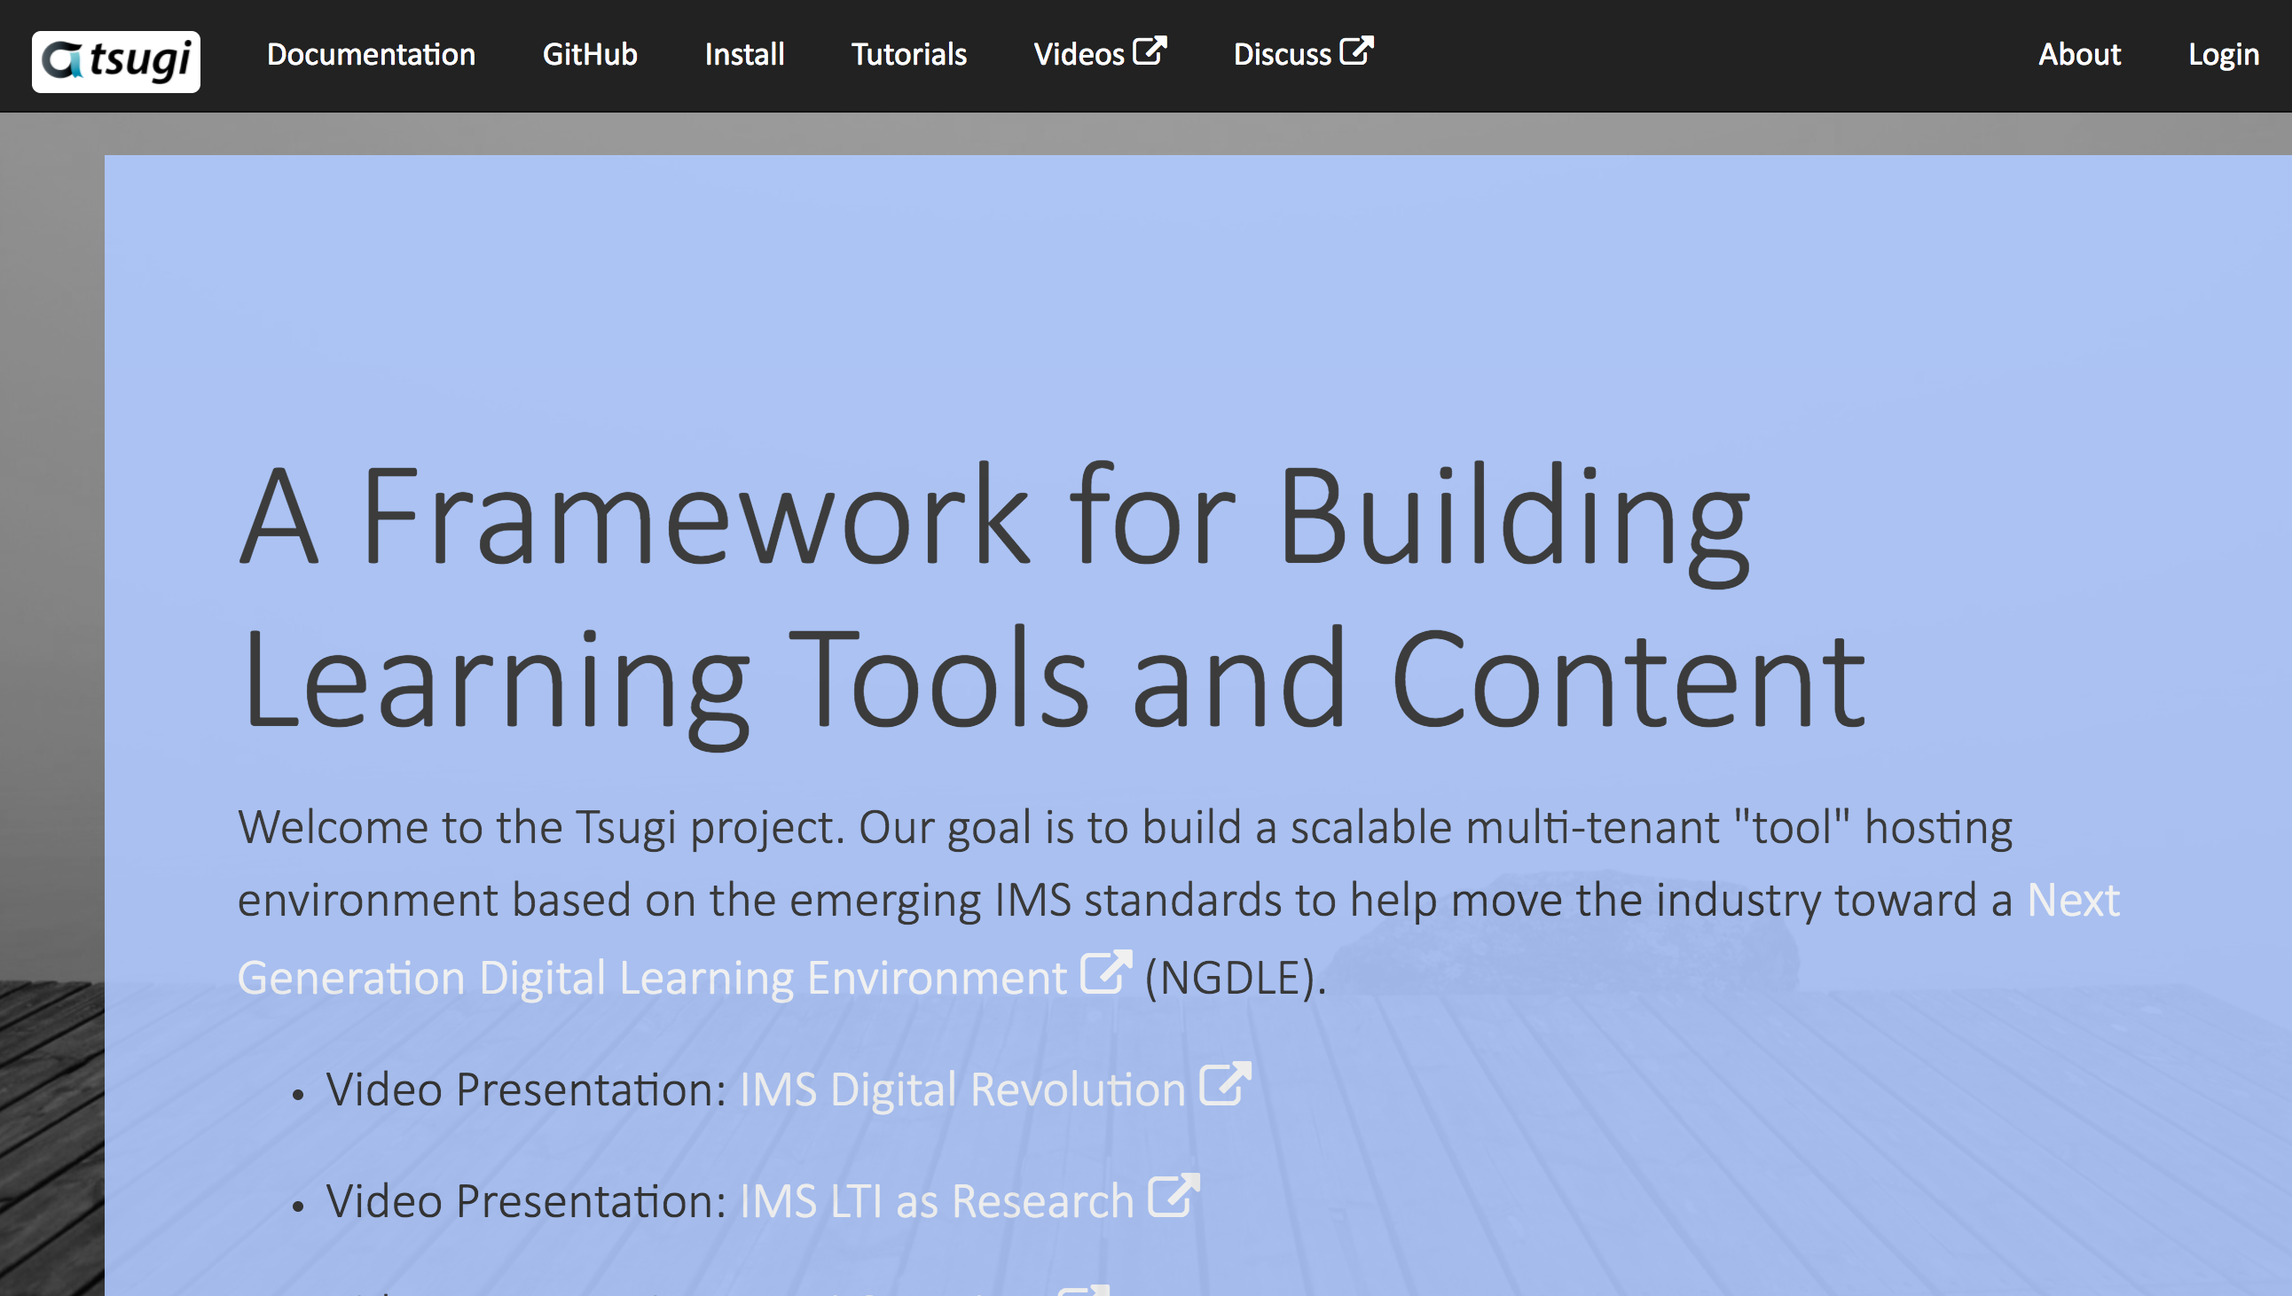
www.tsugi.org

Slide 19
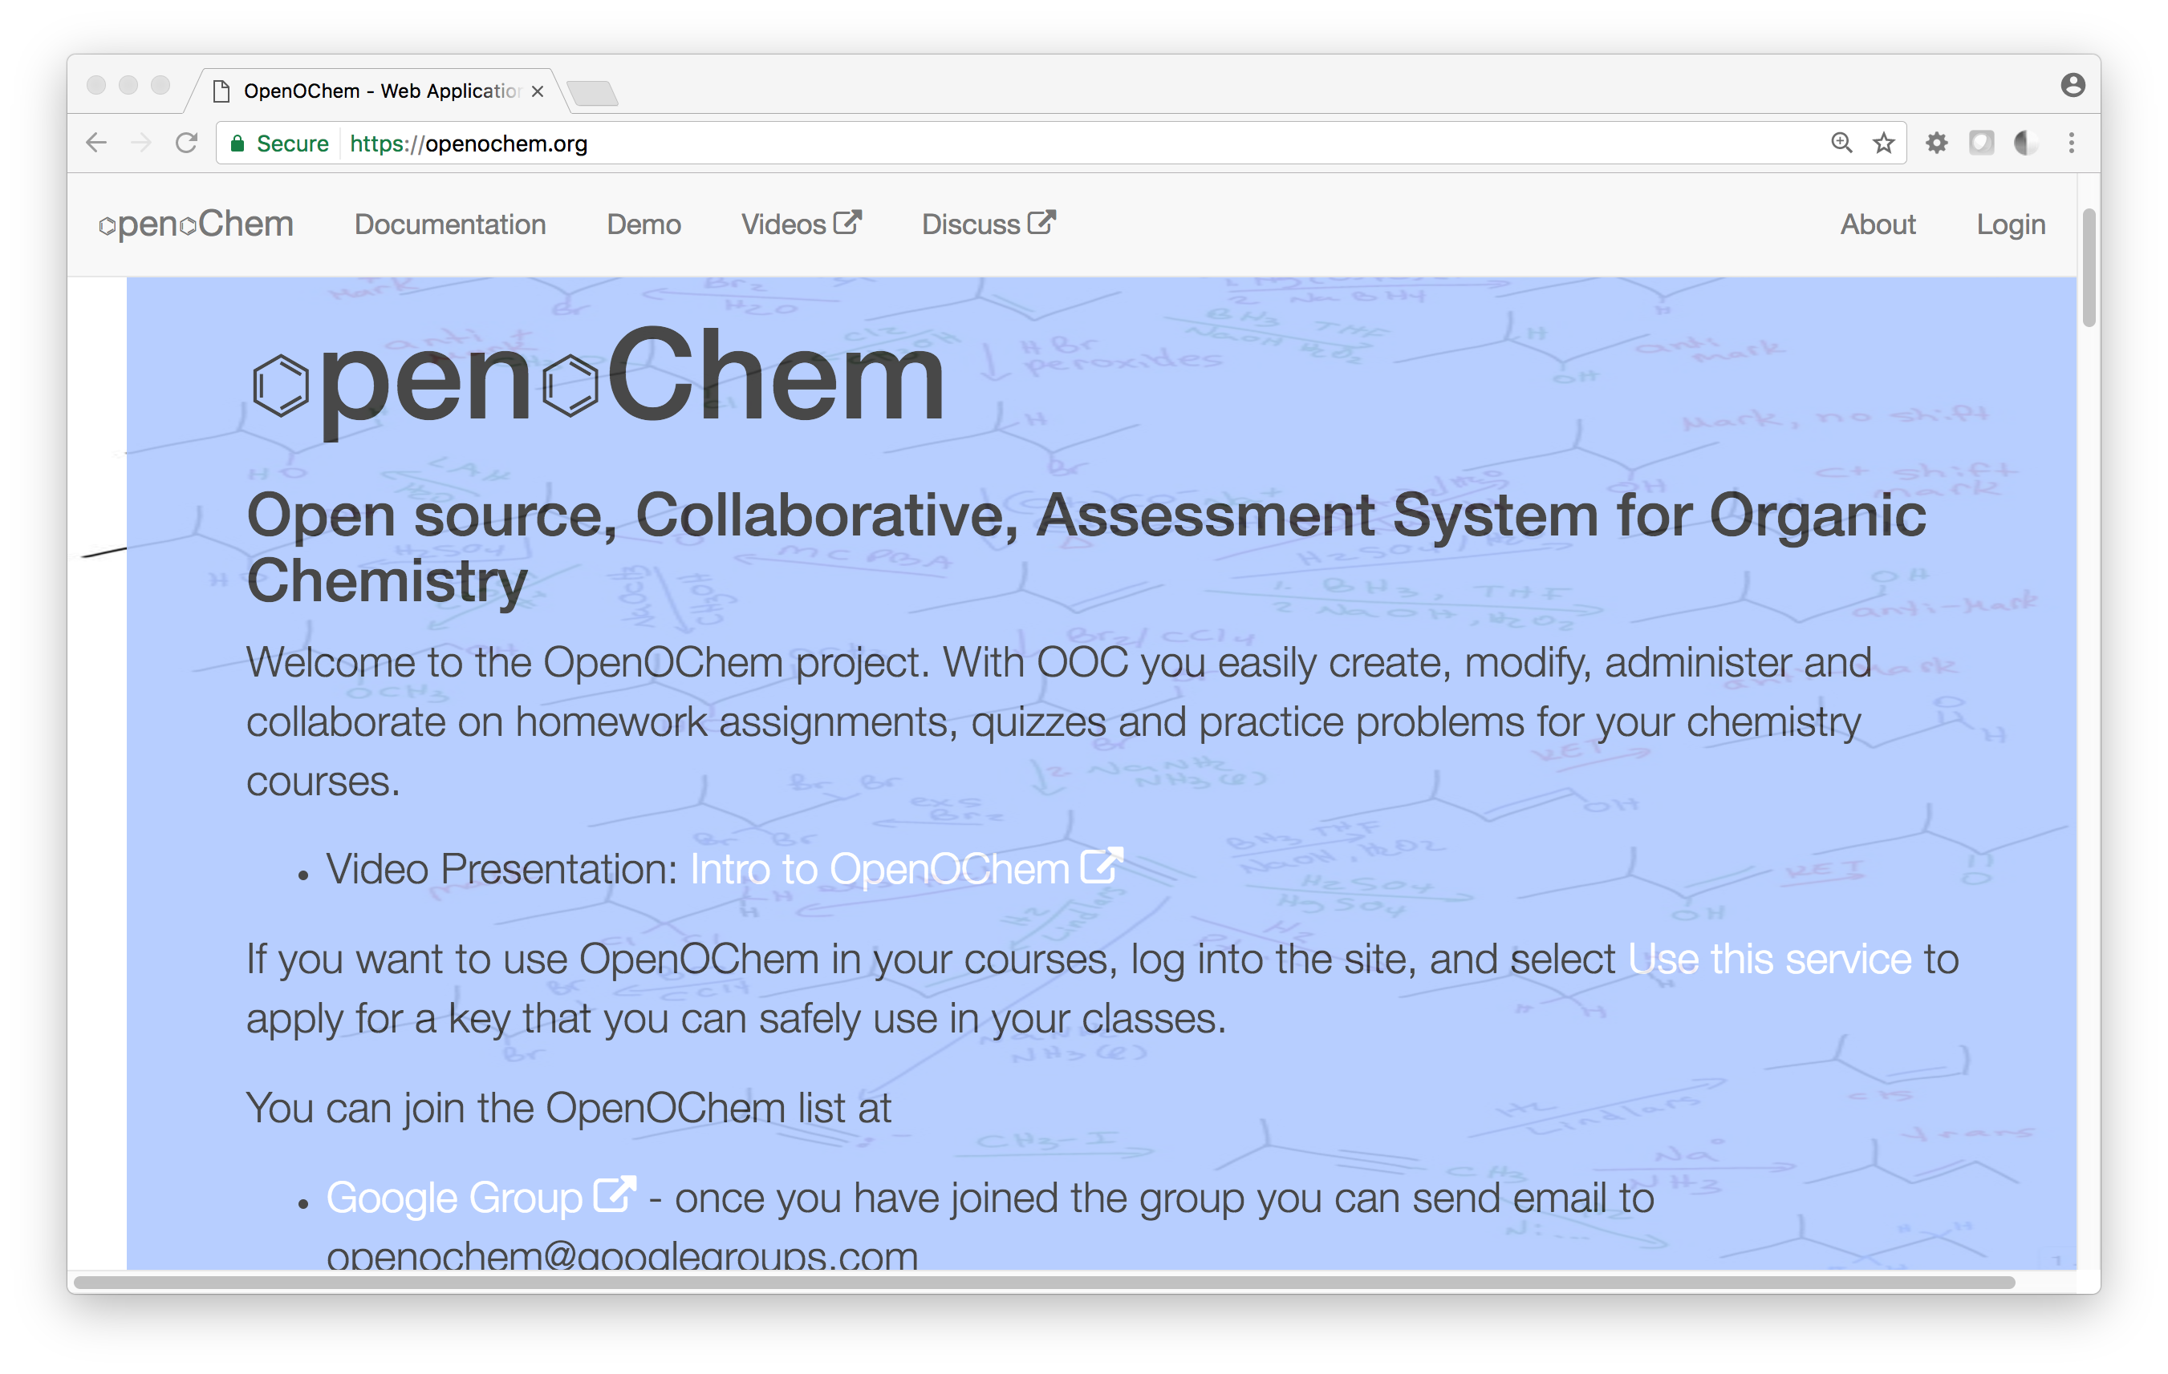
Notes:
Carl LeBlond – Indiana University of Pennsylvania

Slide 20
Tsugi (次) is "EduPress"
Course-Oriented LMS / Standalone MOOC
App Store for Learning Applications
Course-Oriented Content Repository
API Libraries – PHP, Java, Python, Node...
Open source standards implementations
Training for Developers (www.tsugi.org)

Slide 21
Tsugi Store
Tsugi
Console
APP
Tsugi
PHP
MySQL
Database
APP
LMS/CMS
APP
CI
Blackboard
Canvas
Sakai
Coursera
Moodle
…
APP
Tsugi
Java
APP
APP
LTI
APP
Tsugi
Node
APP
APP
Python
Test
CC
Tsugi
LOR

Slide 22
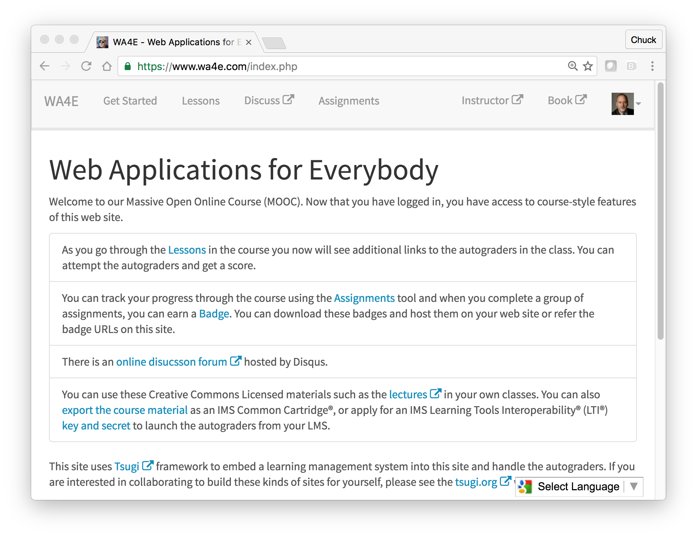
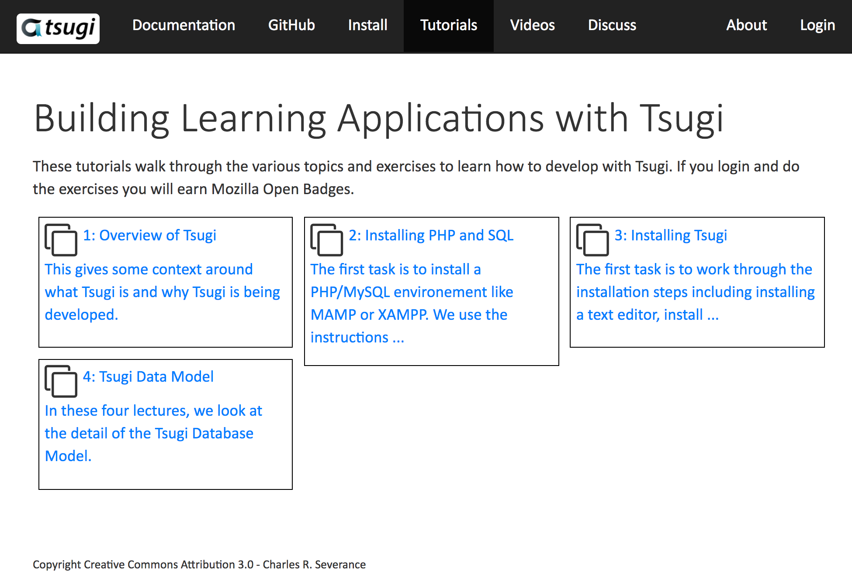
WA4E.com
tsugi.org

Slide 23
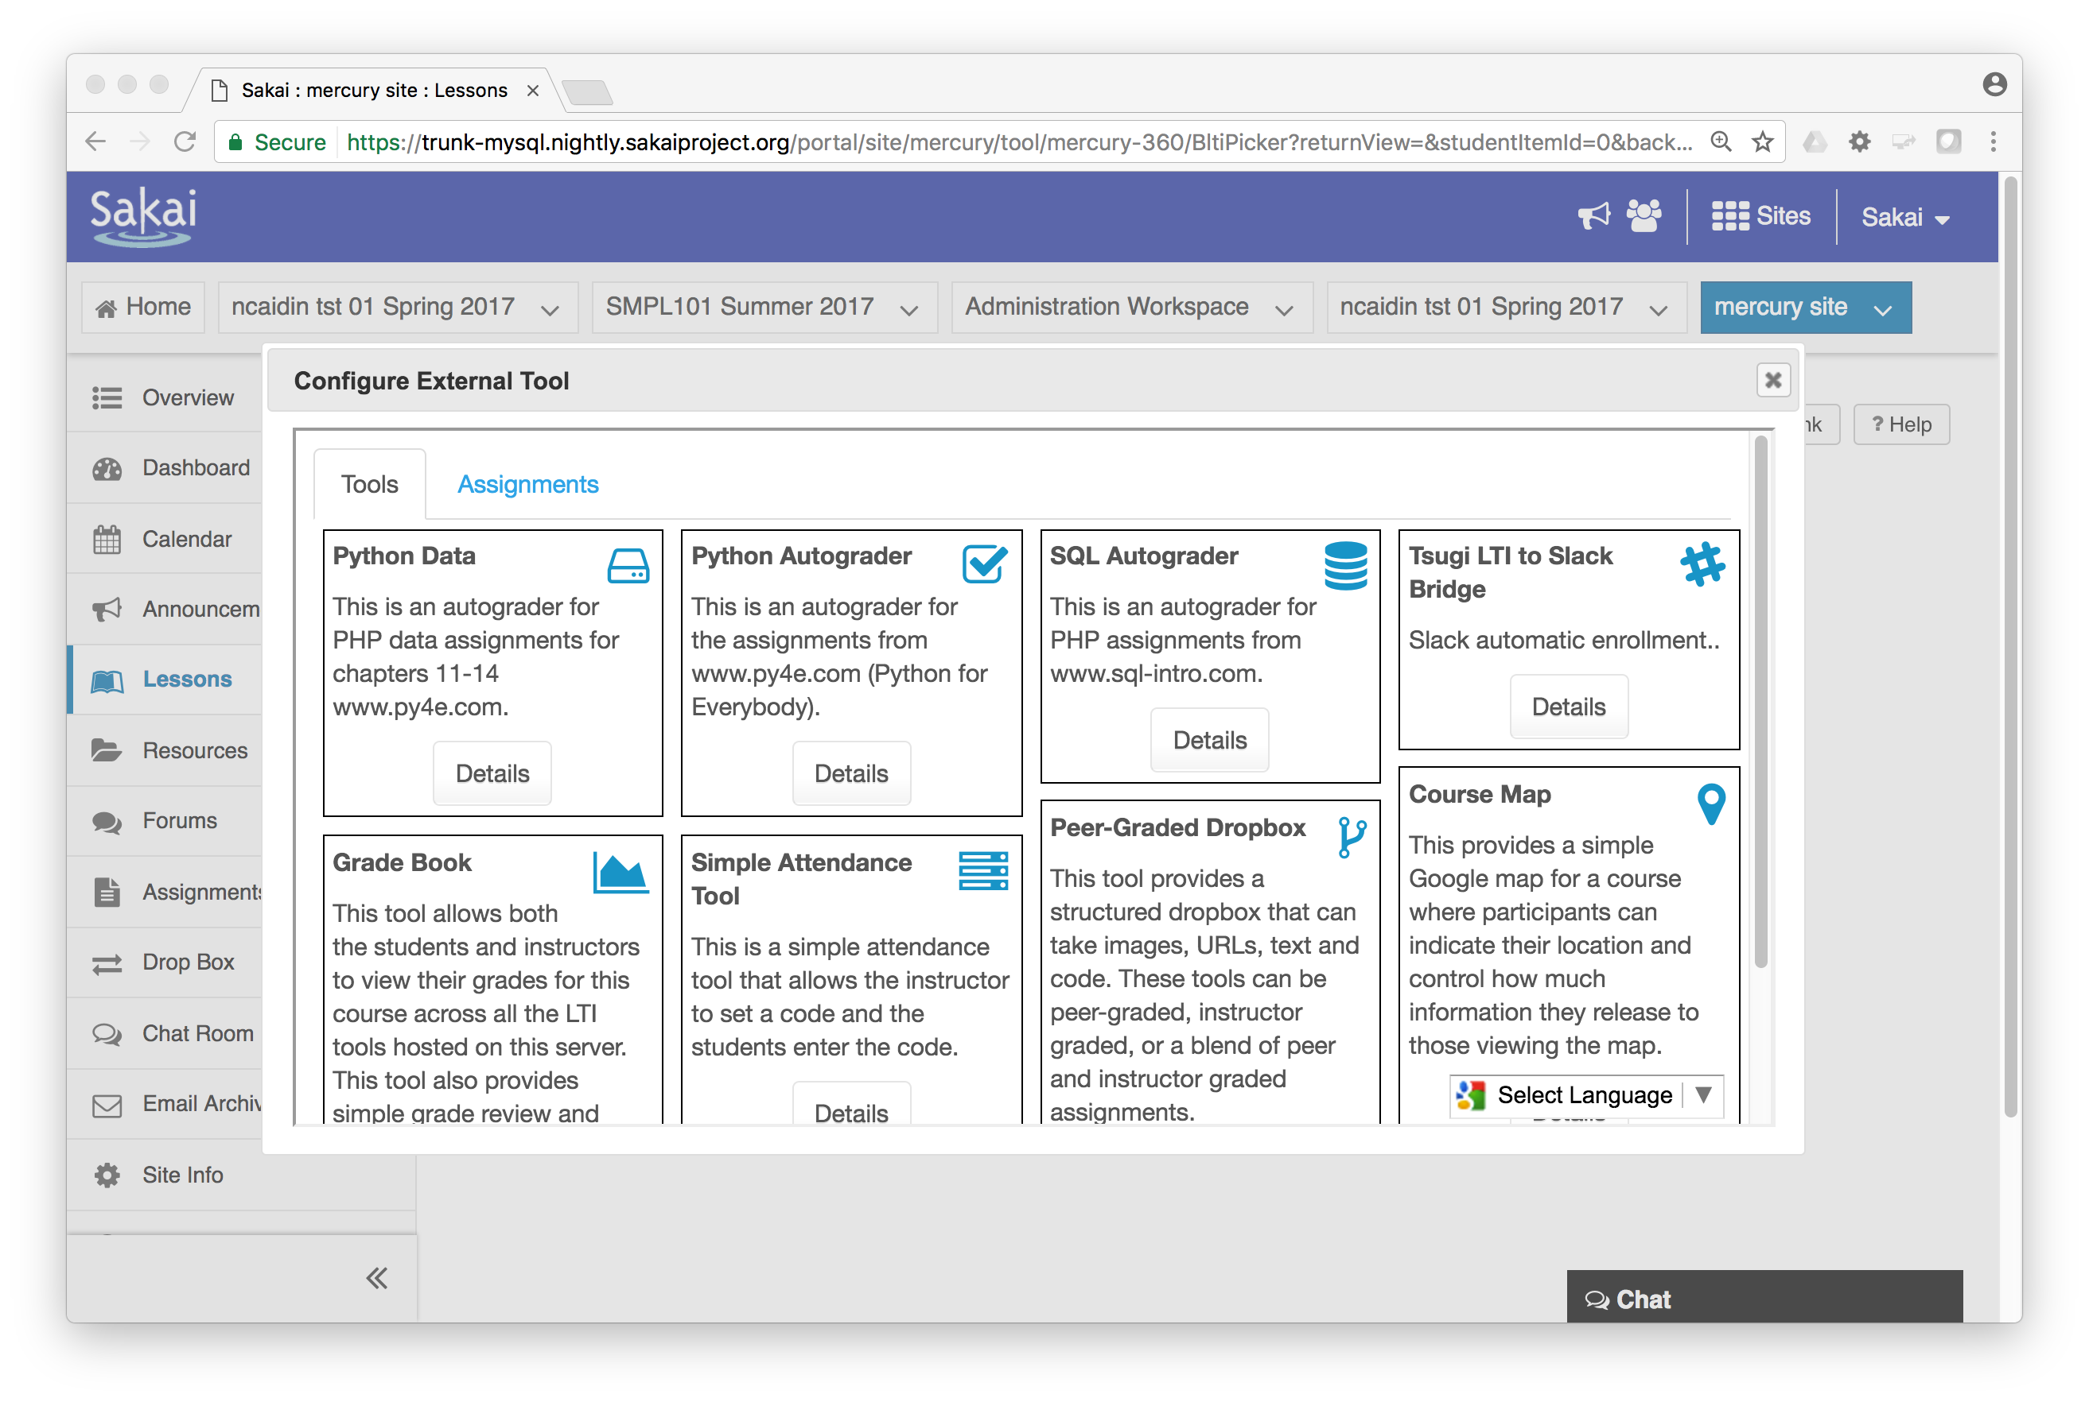

Slide 24
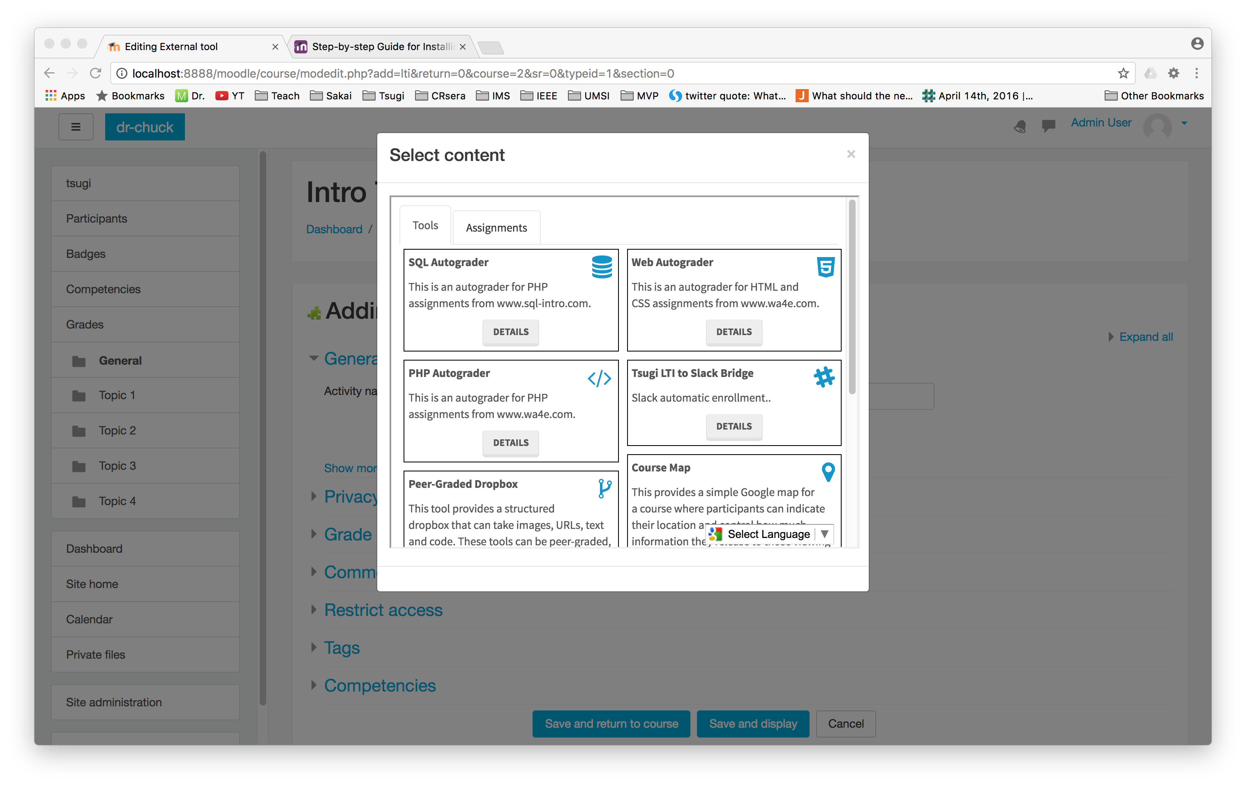

Slide 25
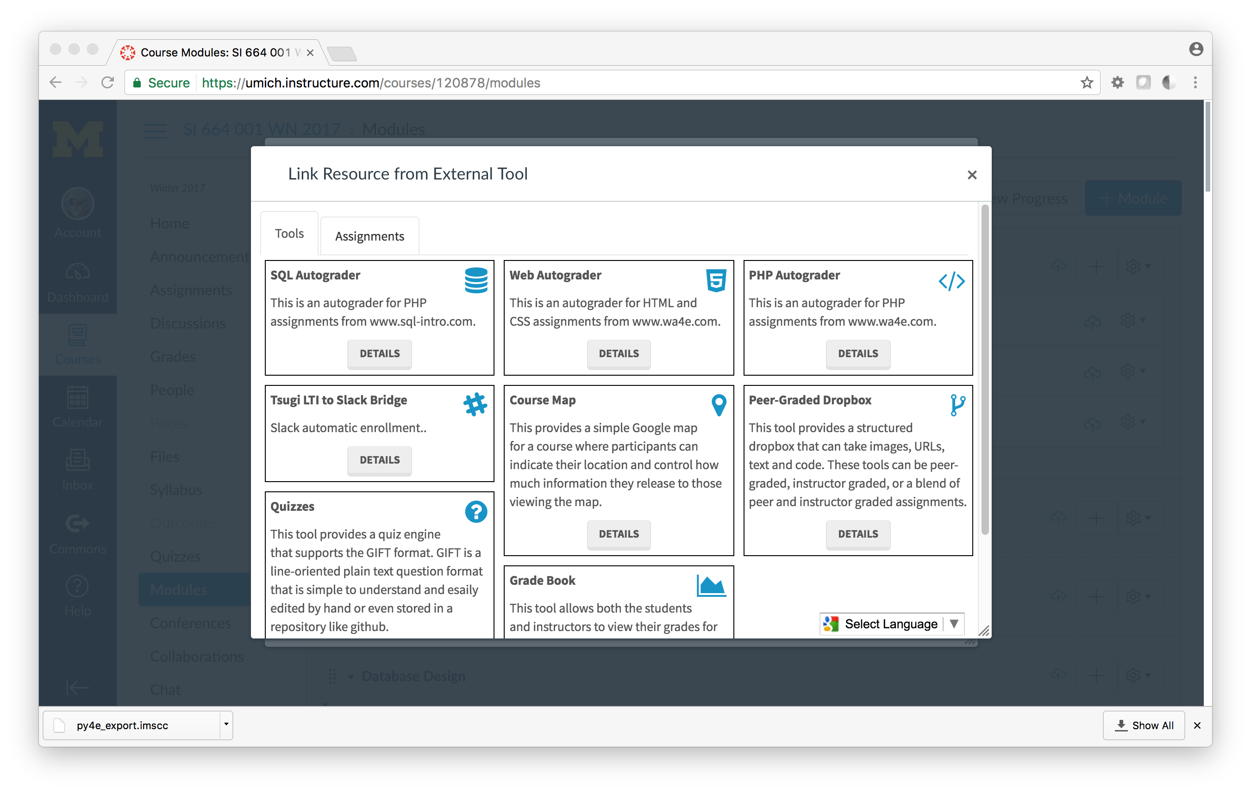

Slide 26
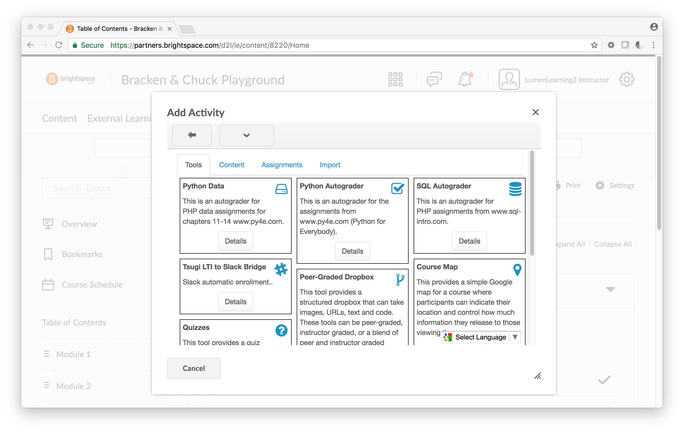

Slide 27
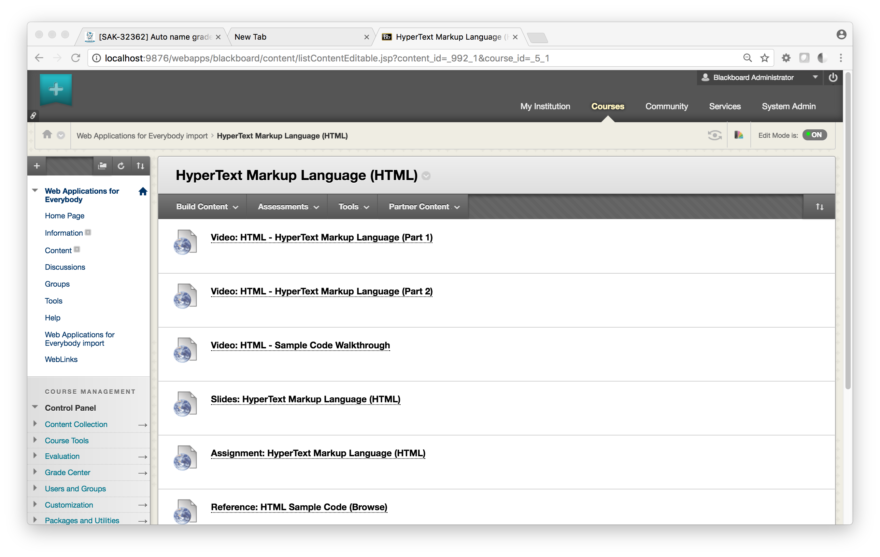

Slide 28
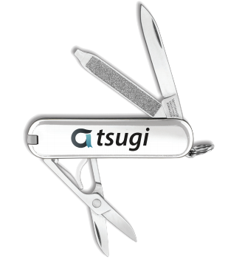
Use Cases
Campus IT Staff – App Store with locally owned data
Instructional Designers – Can focus programmers on building functionality – not reading standards
Faculty – Can build learning content once and use it over and over – content can be open
Book Authors - Can build a site with supporting materials and software with seamless integration into LMSs

Slide 29
Use Cases
OER Publishers – Excellent way to share truly reusable and remixable software and content
MOOC Platform – Small Schools / Single Course / Professional Society
EdTech Startups – A couple of students can have a seamlessly integrated learning tool at MVP in weeks
LMS Vendors – Can encourage their customers to easily build tools that work smoothly rather than break

Slide 30
Source: Ian Dolphin

Slide 31
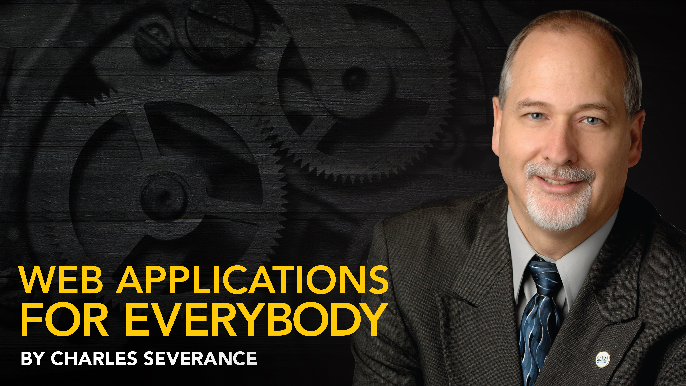
Teaching Developers: MOOCs www.py4e.com www.wa4e.com www.tsugi.org

Slide 32

Tsugi is Ongoing Research
Growing, evolving based on experiments (0.3.1)
In incubation as a open source project in the Apereo Foundation (please join and support Apereo)
Participating in IMS Working Groups
Expect 1.0 release early 2018
Need friendly adopters
Need skilled collaborators
Raising funding for grad students, travel, etc
www.tsugi.org

Slide 33
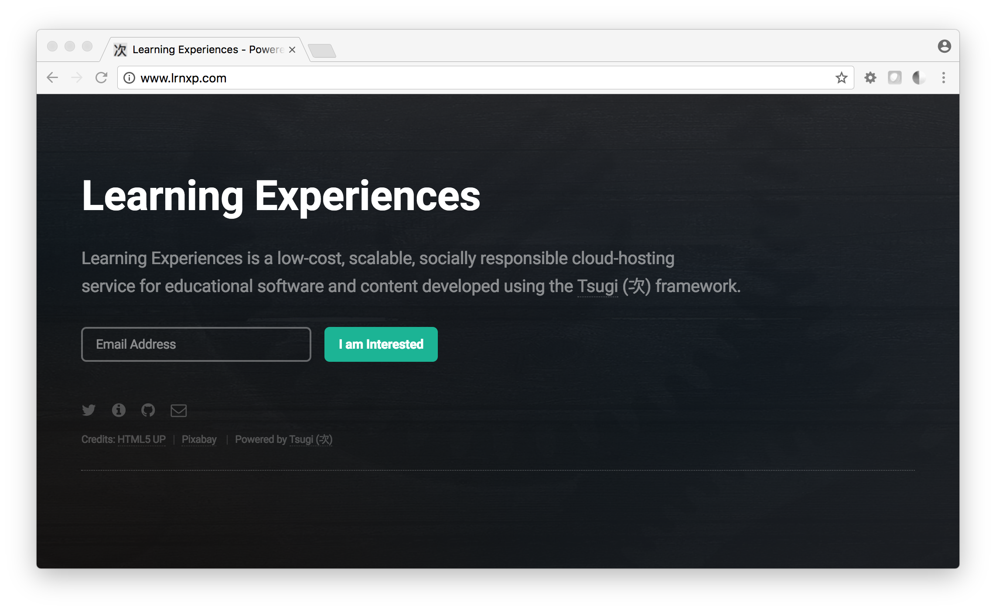

Slide 34
A Few Questions…
Show me how beautiful an LTI Tool's UX can be
Show me the Tsugi Learning Object Repository integrated into Canvas or Sakai
Show me how you use Tsugi to support your Coursera MOOCs
Show me how to set up a Tsugi App Store for my Campus
Show me how easy it is to add a new application to Tsugi
Talk about why we need a good data model for multi-tenancy, etc.
I teach a Computer Science Capstone course…
Show me where to start learning more...

